Slide 1

Kevin Cookie Business Analysis using Excel
About the Project
In this project ,I performed a business analysis for a multinational cookie manufacturing company with locations in Canada, the United States, Mexico, France, and Germany. Microsoft Power BI was used exclusively for this analysis and visualization, which focused on the company’s sales performance for the years 2018 and 2019. The company dataset was provided by Kevin Stratvert, a content creator and former Microsoft product manager.
Aim
The analysis aimed to analyze the company’s performance and proffer insights to increase profits
About the Data
The Kevin Cookies dataset contains sales, revenue, and profit data for 2018-2019, segmented by region and product type."
Procedure Followed:
1. Data Collection and Cleaning:
Collected Data: Compiled sales data for 2018 and 2019

Slide 2



.
Data Cleaning:
Removed duplicate records to ensure data integrity.
Handled missing values to maintain consistency.
Standardized column values (e.g., converted "1" to "Churned" and "0" to "Not Churned").
2. Data Transformation:
Structured Data: Organized the raw data into a structured format using Excel.
Calculated Key Metrics: Created new columns for profit margins, growth percentages, and other key metrics to track performance.
Aggregated Data: Consolidated sales data by region, product, and year for analysis.
Data Analysis and Insights Generation:
Excel PivotTables: Used PivotTables in Excel to analyse sales trends by region, product type, and year.
Product Performance Analysis: Identified which products generated the highest revenue and which ones underperformed.
Year-over-Year Comparison: Compared 2018 vs 2019 data for revenue, profit, and growth to reveal key trends.

Slide 3


Data Visualization and Presentation:
Charts and Graphs: Created Excel charts (bar, line, and pie charts) to visualize trends in sales, revenue, and profit.
PowerPoint (PPT): Created a PowerPoint presentation to showcase the business analysis findings, key insights, and recommendations to stakeholders.
Navigation Buttons:
Created interactive buttons in Excel to allow users to seamlessly navigate between different sheets within the workbook.
Enhanced the workbook's usability by making it easier for stakeholders to access different sections of the analysis and data.

Slide 4
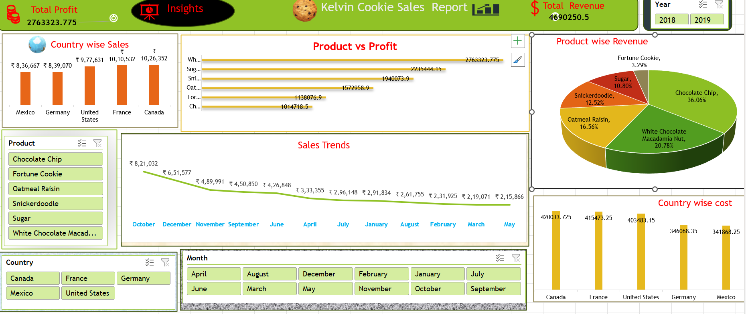
Dashboard

Slide 5
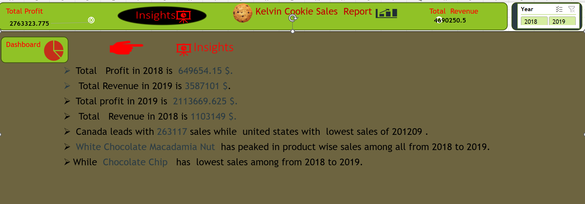

Slide 6
Key Insights:
Revenue and Profit Growth: Total revenue grew by $2.4 million from 2018 to 2019, with a 200% increase in profit.
Regional Insights: Canada led in total sales, while the United States showed the lowest sales, indicating an opportunity for improved strategies in the U.S. market.
Product Insights: The White Chocolate Macadamia Nut cookie saw the highest sales growth, while Chocolate Chip had the lowest, indicating a need for re-evaluation of product offerings or marketing efforts.

